Slide 1

MEMBER MANAGEMENT
July 20 & 28 ,2024

Slide 2
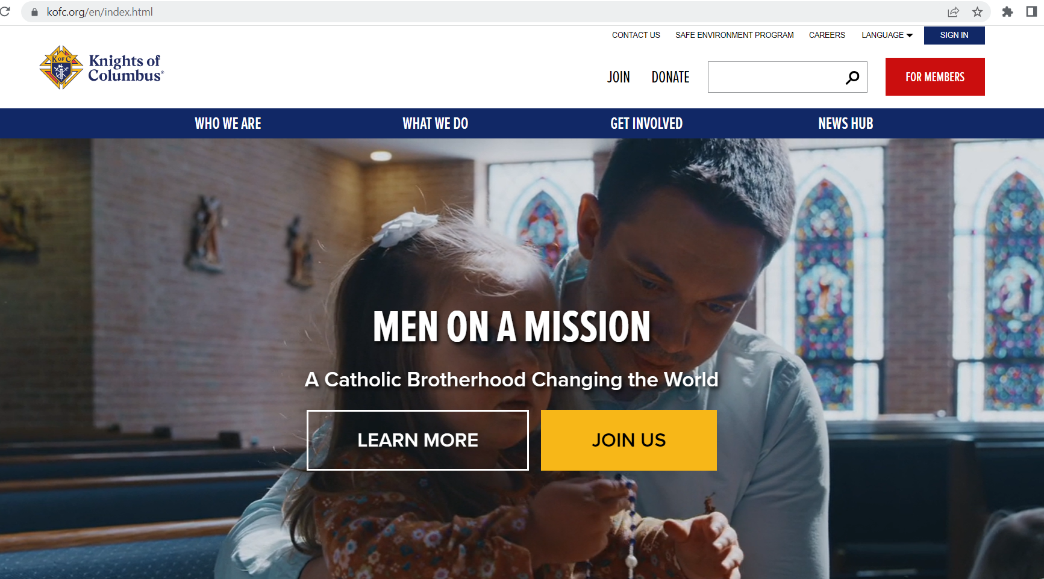

Overview
Officer’s Online is a secure portal that, depending on officer position, allows access to council records
Member Management allows viewing and modifying of member records and to update council officers & directors
Member Billing is used for council income and expenses

Slide 3
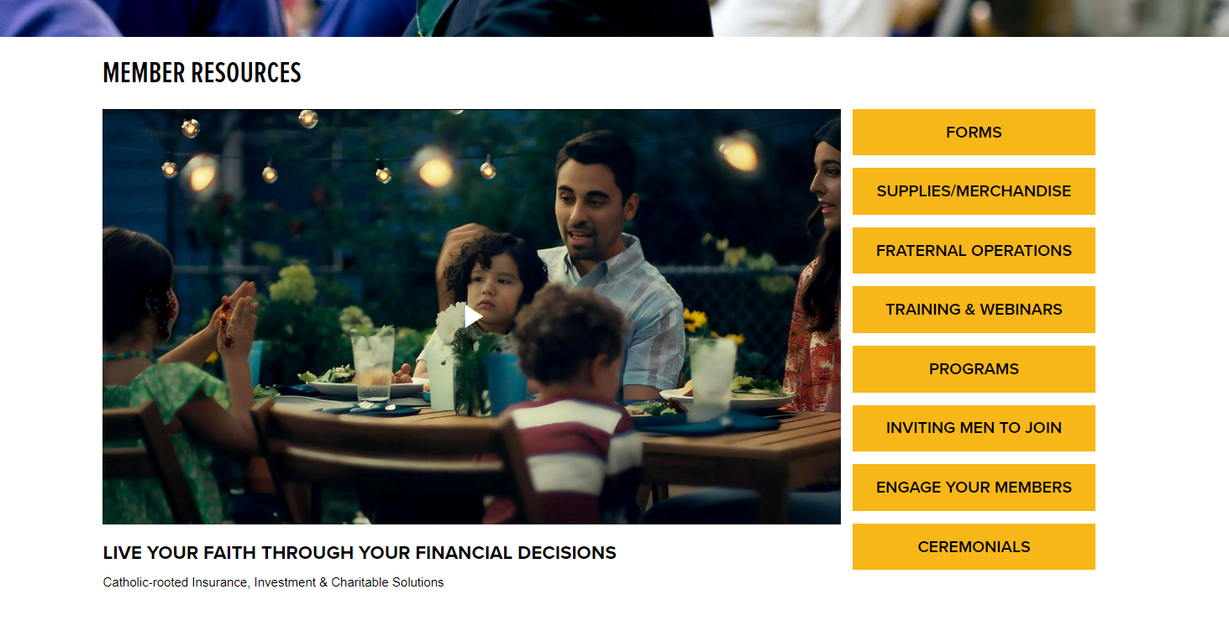


Slide 4
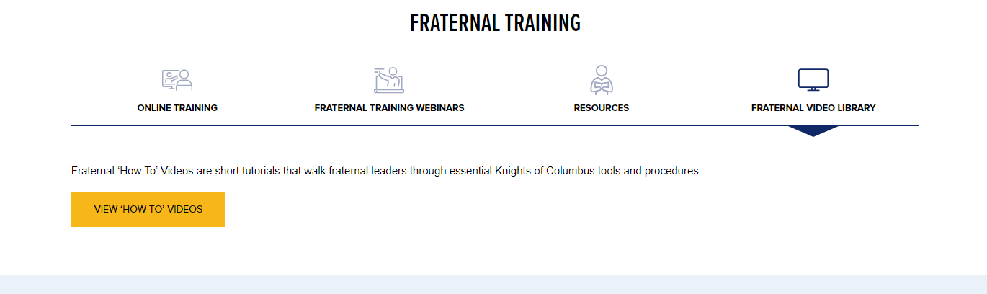


2

Slide 5
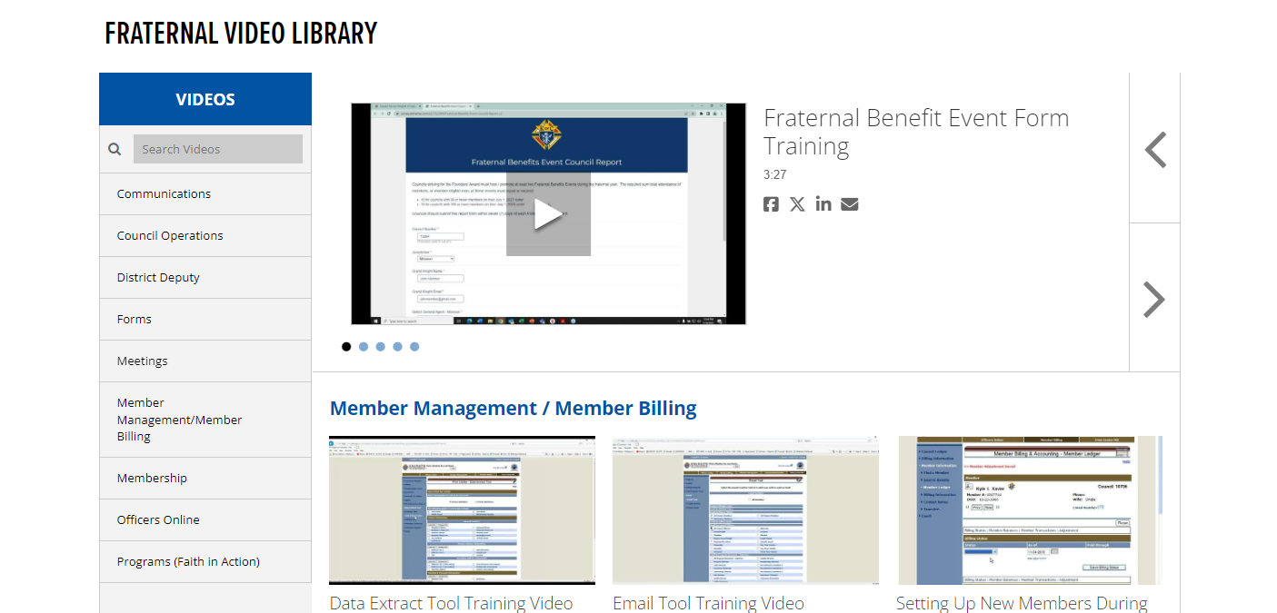

Slide 6
Overview
Officer’s Online is a secure portal that, depending on officer position, allows access to council records
Member Management allows viewing and modifying of member records and to update council officers & directors
Member Billing is used for council income and expenses

Slide 7
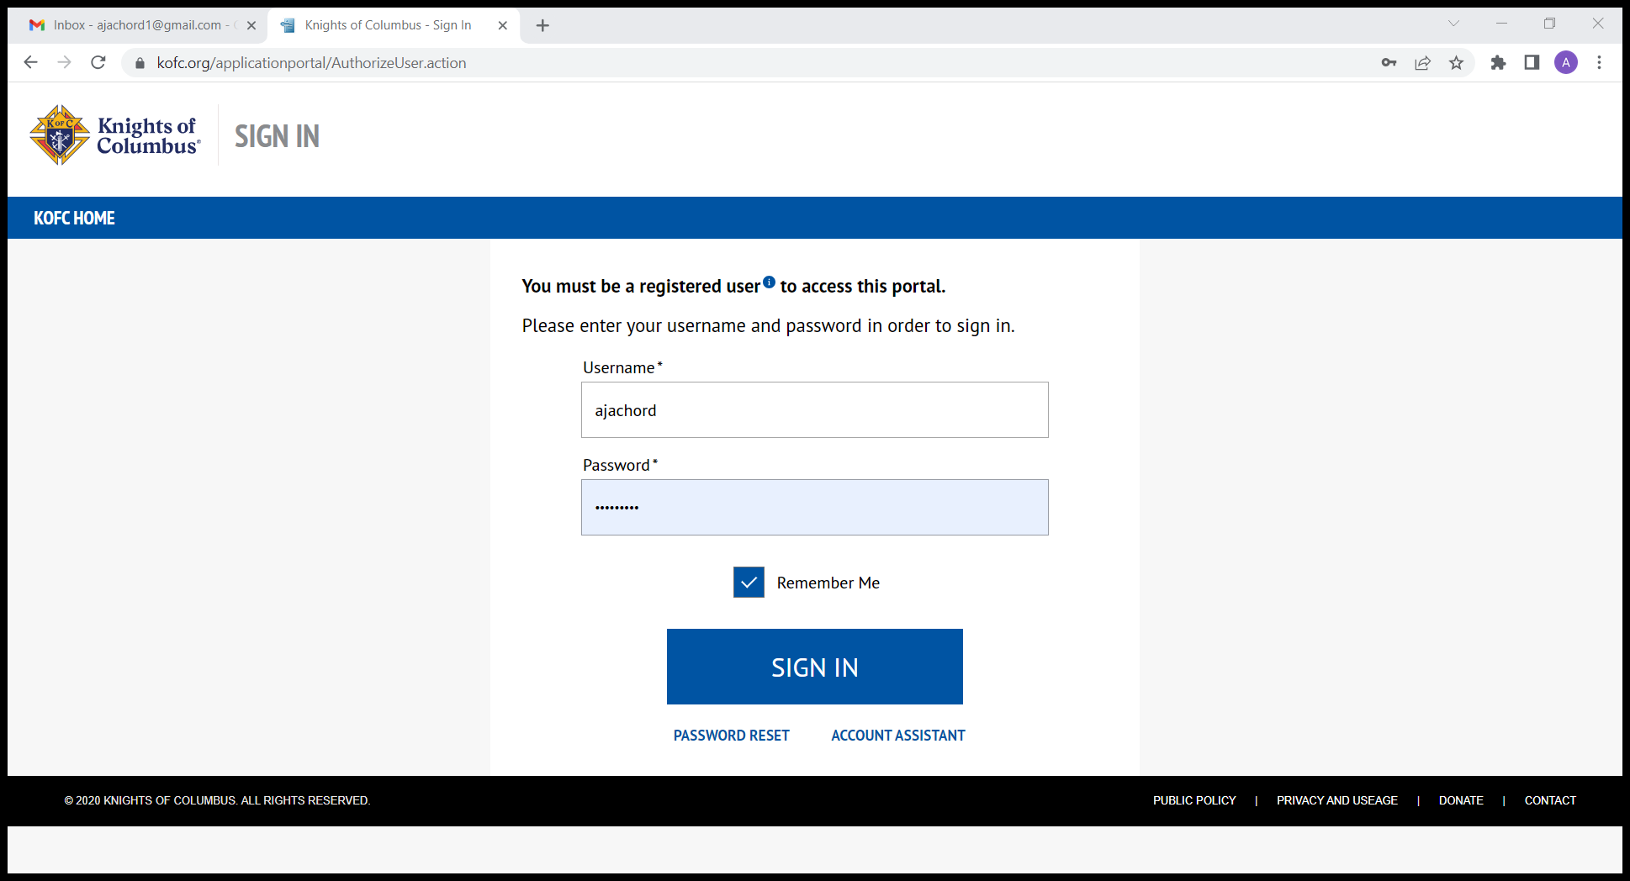

Slide 8
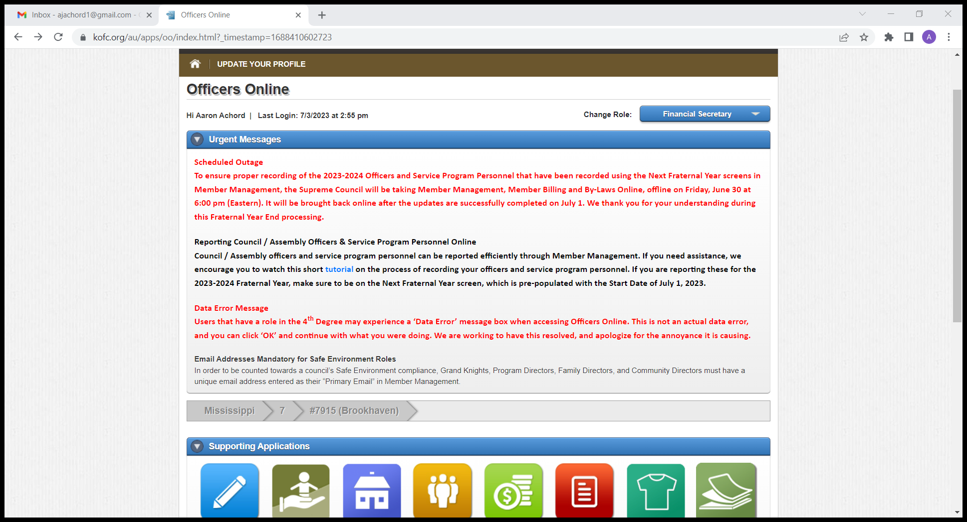

Slide 9
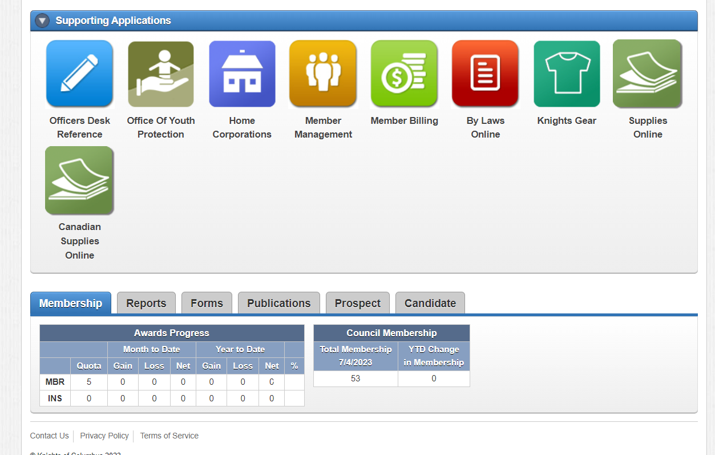
Scroll down to see this portion of screen

Slide 10
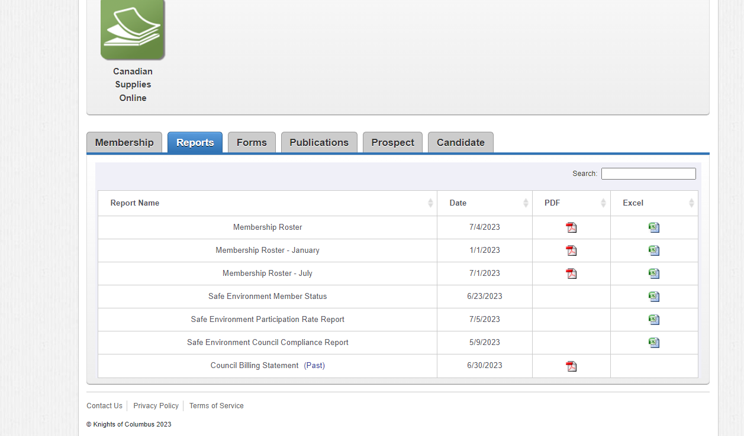

Slide 11
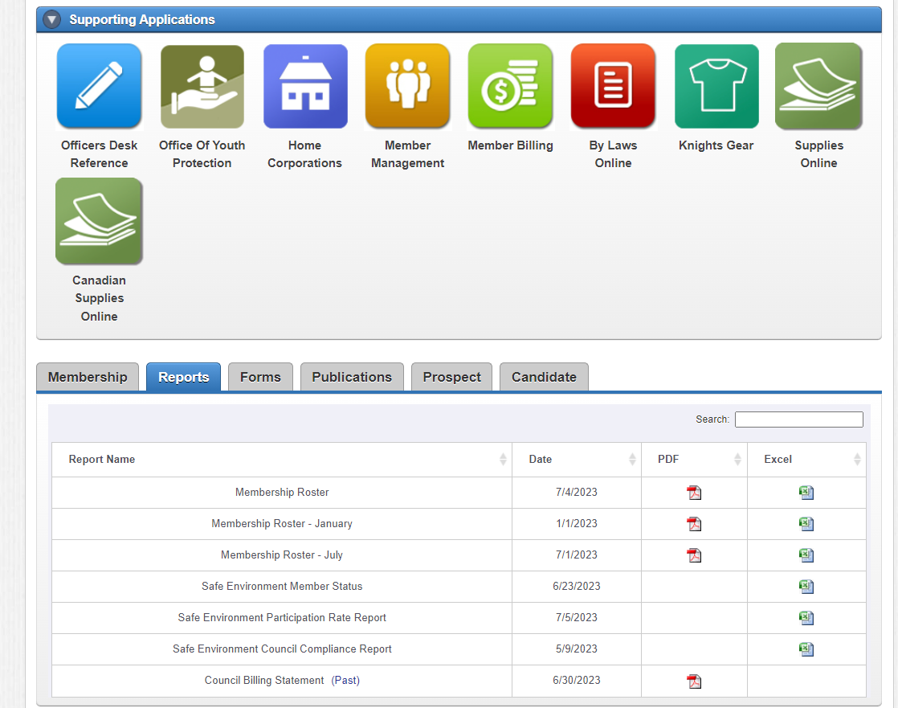


Slide 13
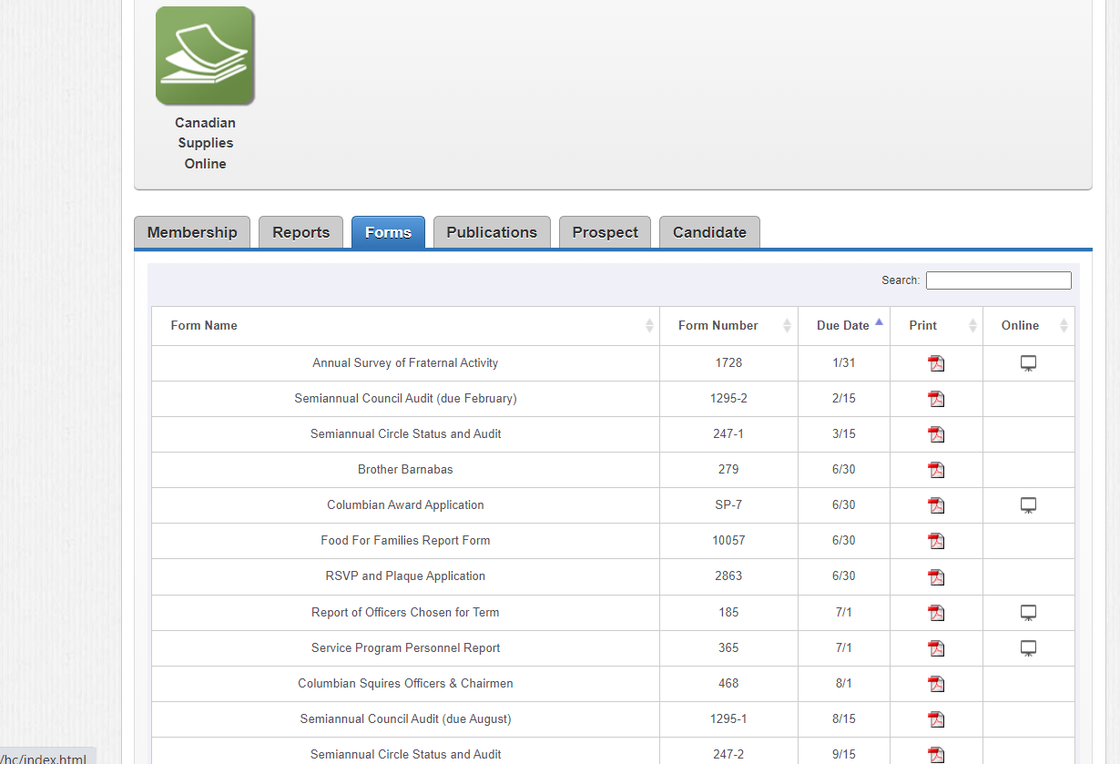

Slide 14
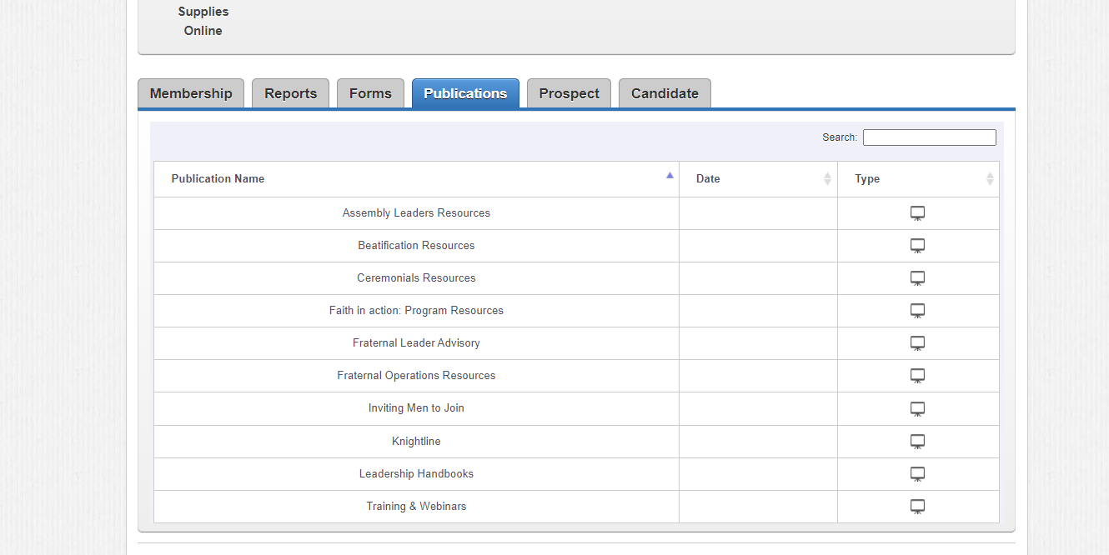

Slide 15
Membership Types

Slide 16

Membership Types
Regular
  Associate (A)
  Insured (I)
Inactive (N)
Honorary (H)
Honorary Life (L)
Affiliate (State Roster)

Slide 17
Processing New Members
There are three methods to Join:
  Online Join (Processed via Prospect tab)
  Form 100
  Candidate Tab

Slide 18
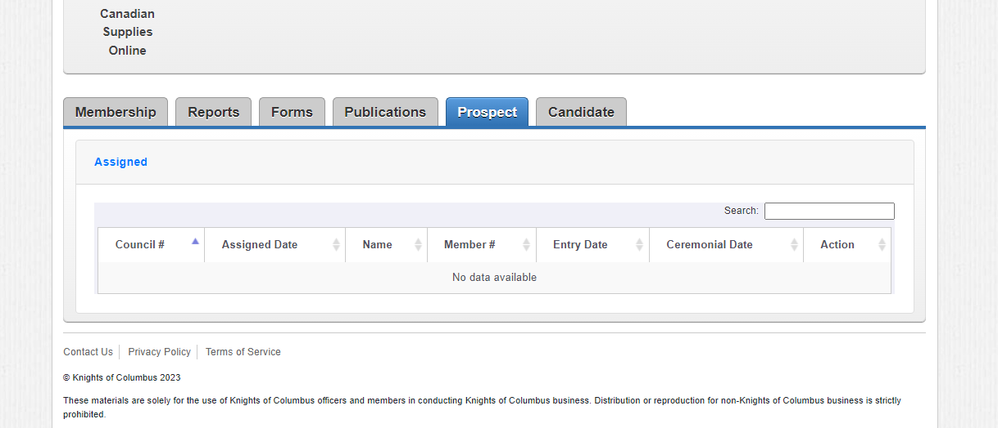

Slide 19
Processing Members

Slide 20
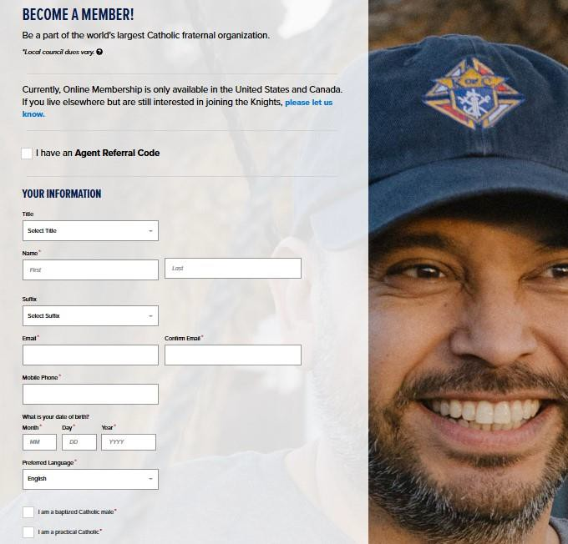
Online Membership
Joins via kofc.org/join

Slide 21
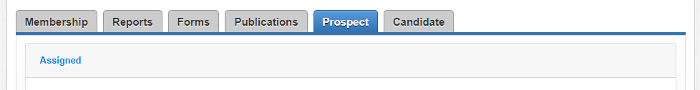
Intake of Online Members
Online members appear on prospect tab
  State assigned him, or
  Member put council number on application

Slide 22
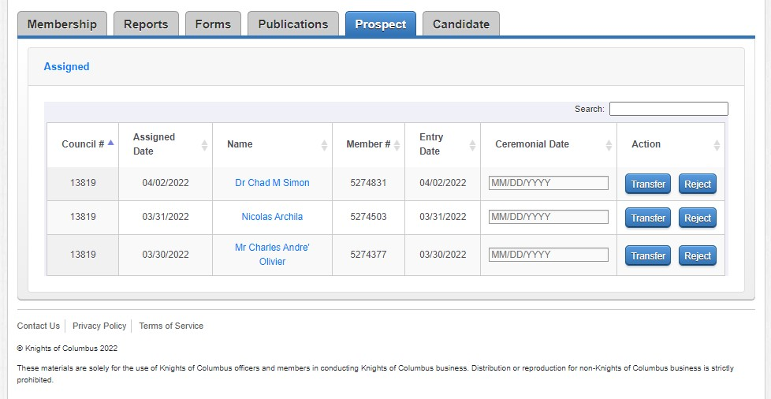
Transferring Online Members into your Council
Hit Transfer

Slide 23
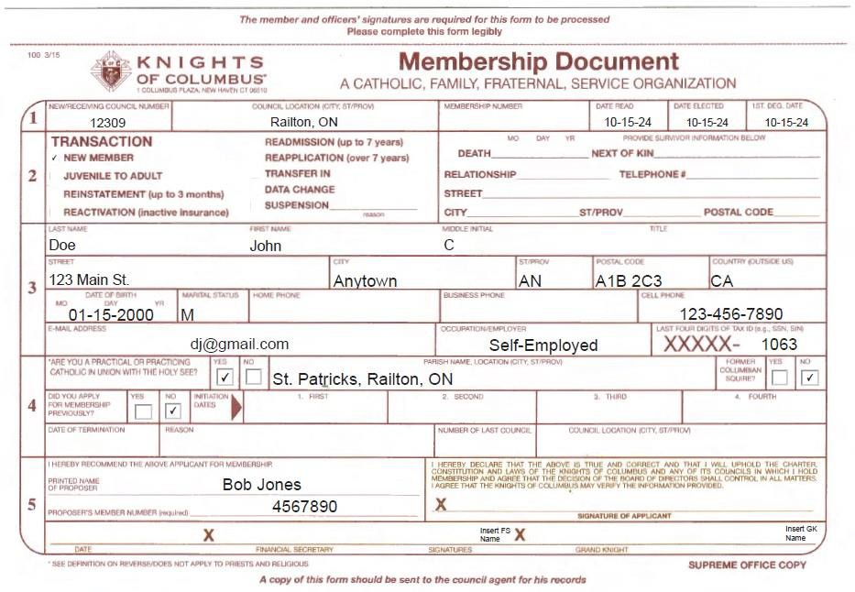
Form 100
New Member fills out Form
3 Signatures are required
Scan & send via email to: membership@kofc.org
FS retains a signed copy

Slide 24
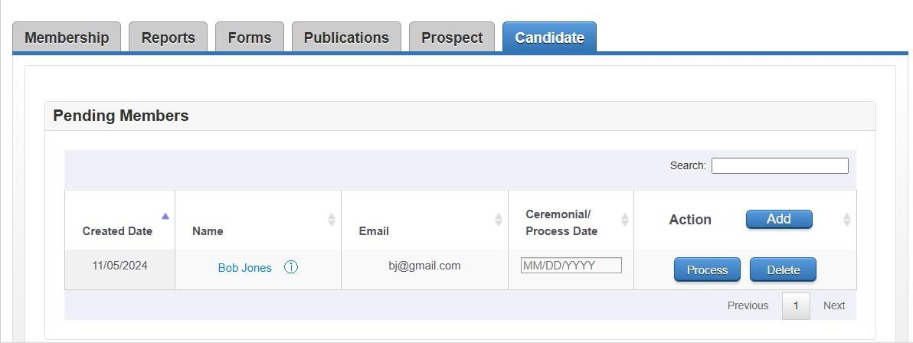
Candidate Tab
Pending Member appears once for is complete
Fill all the
Information appears on the Pending Members List

Slide 25
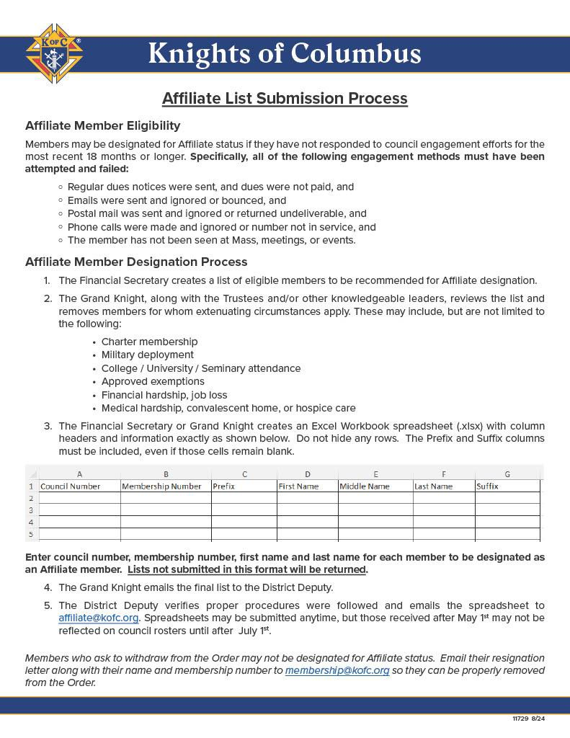
Affiliate Membership Procedures
Follow the Affiliate List Submission Process – # 11729

Slide 26
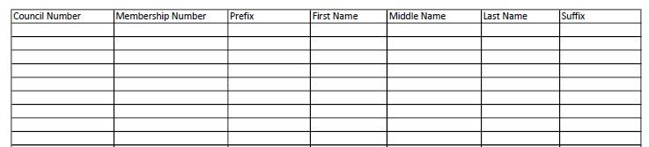
Affiliate Spreadsheet
Enter council #, membership #, first name & last name

Slide 27
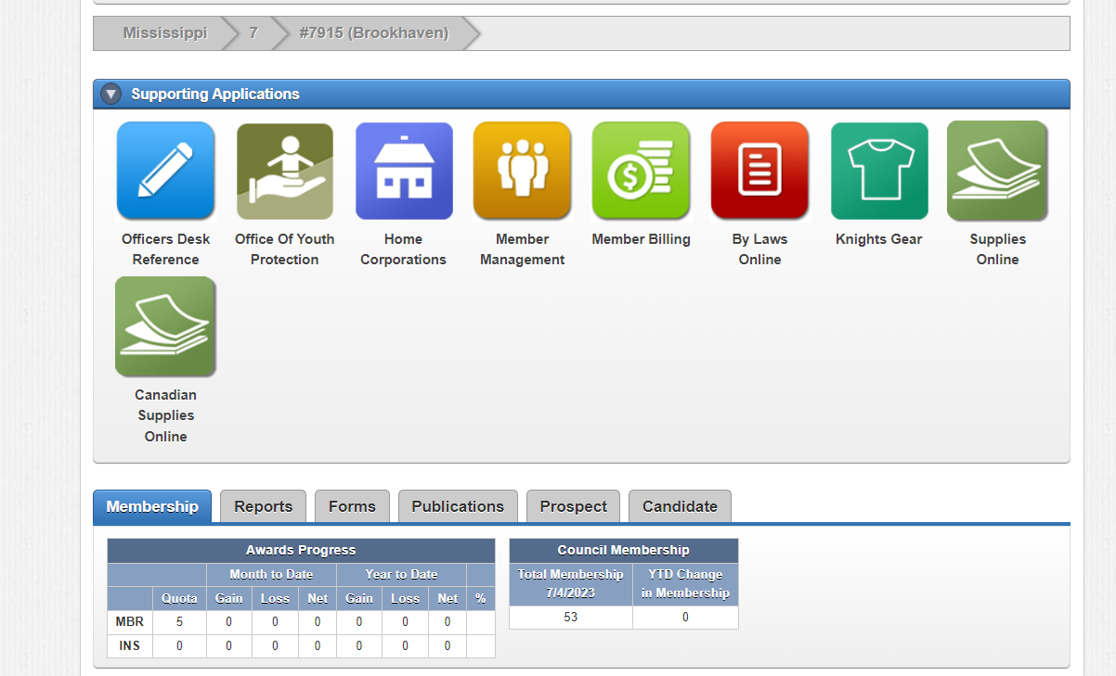
Select Member Management Block

Slide 28
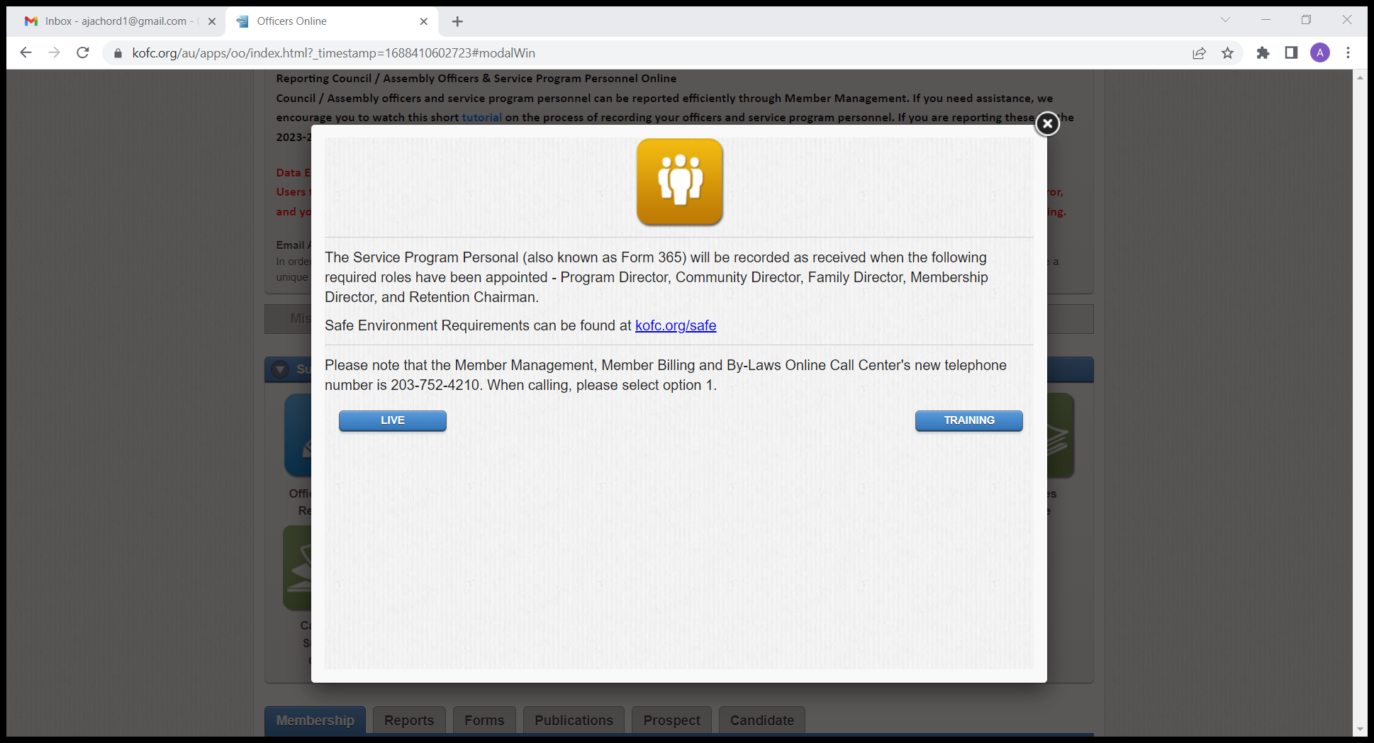

Slide 29
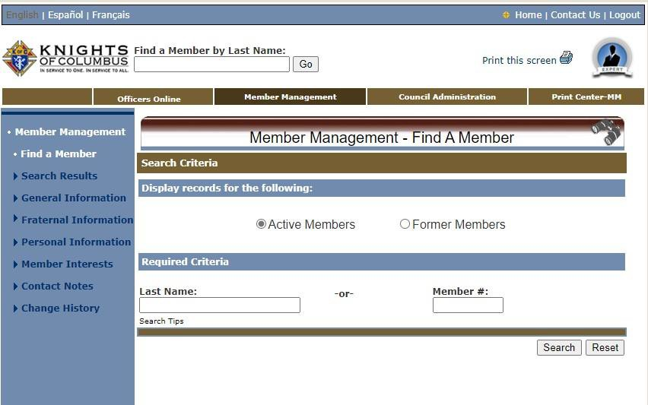
Find a Member
Allows searching members by name or member #
Enter a few letters of last
name
Or by member #
Click “Search”
Active – Ins. Or Assoc.
Former – Inactive Ins.

Slide 30
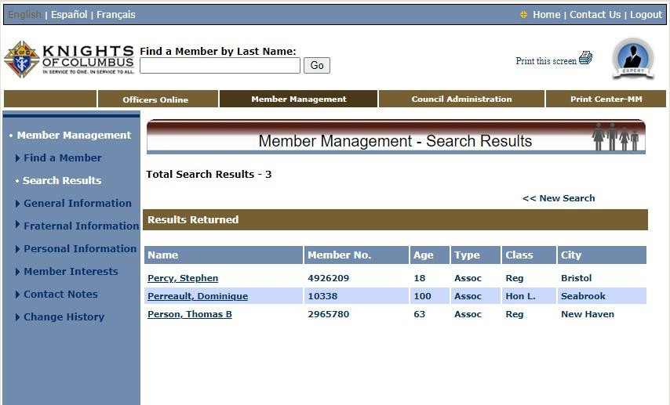
Find a Member
– By Name
Shows search results for “Per”
Select the member of
choice
Click on Name to pull up profile

Slide 31
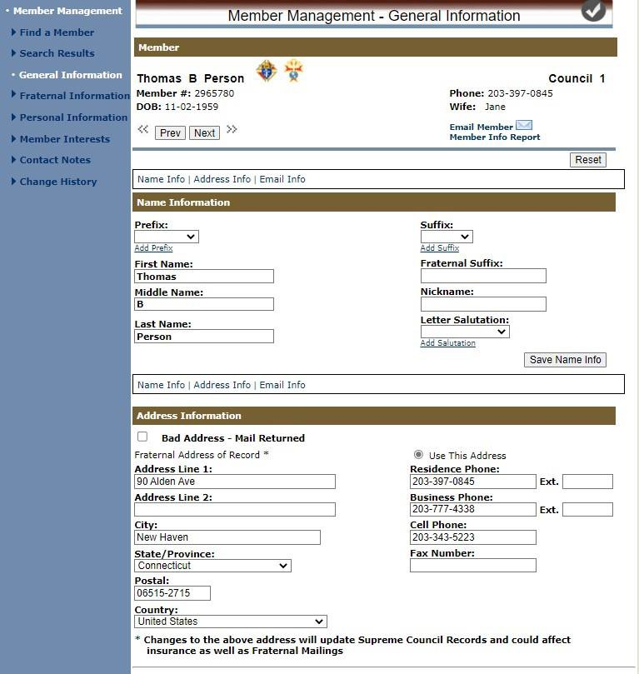
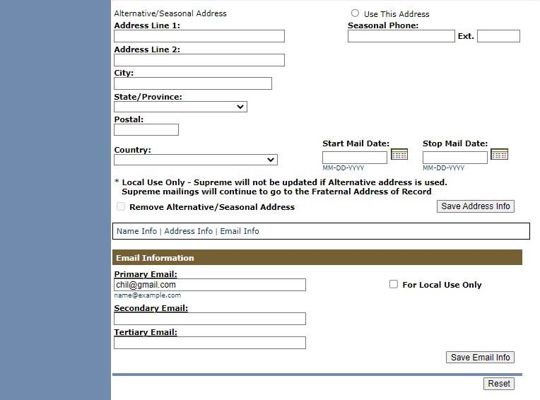
MM – General Information

Slide 32
MM – General Information: Remove Phone #
Making edits is easy
Let’s remove a phone number
Notice highlighted Business number
Clear the numbers from the field

Slide 33
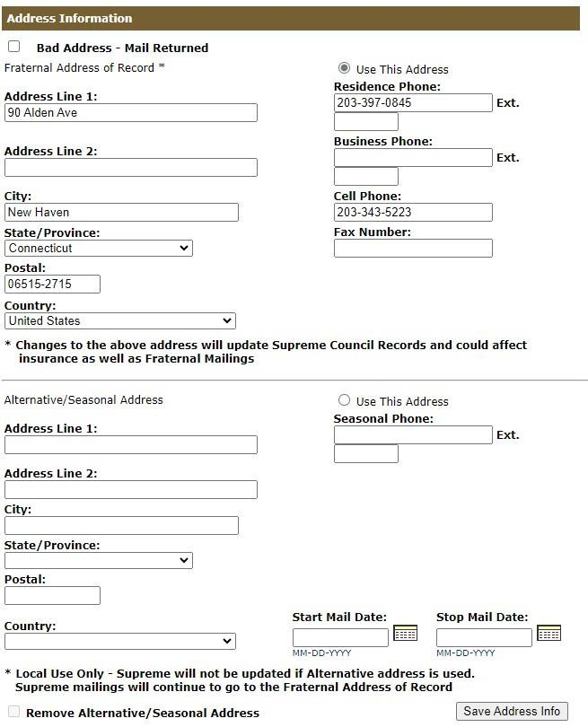
MM – General Information: Remove Phone #
The number field is blank
CLICK the “Save Address Info button to update the data with Supreme
All reports going forward will now reflect this change

Slide 34
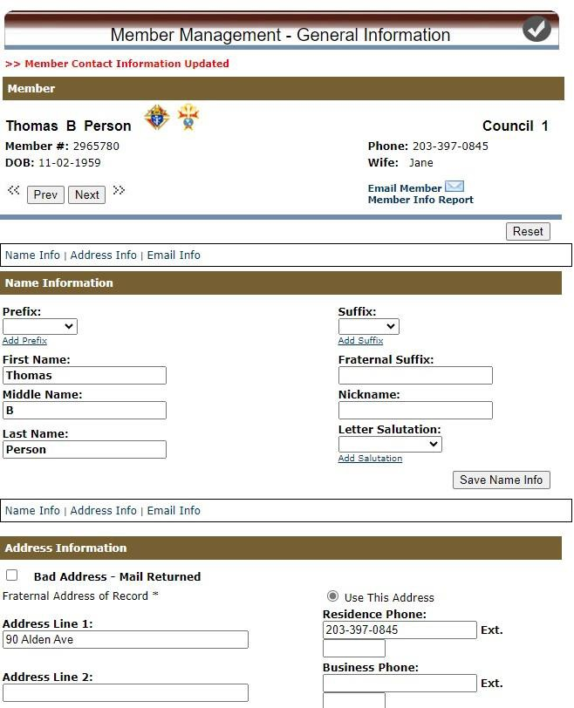
MM – General Information: Remove Phone #
The information is now saved
Supreme notifies with a message (note the “RED” text at the top of page)
If you make a change and leave without saving, you will get a message reminding that you have unsaved changes (allowing you to correct the error)

Slide 35
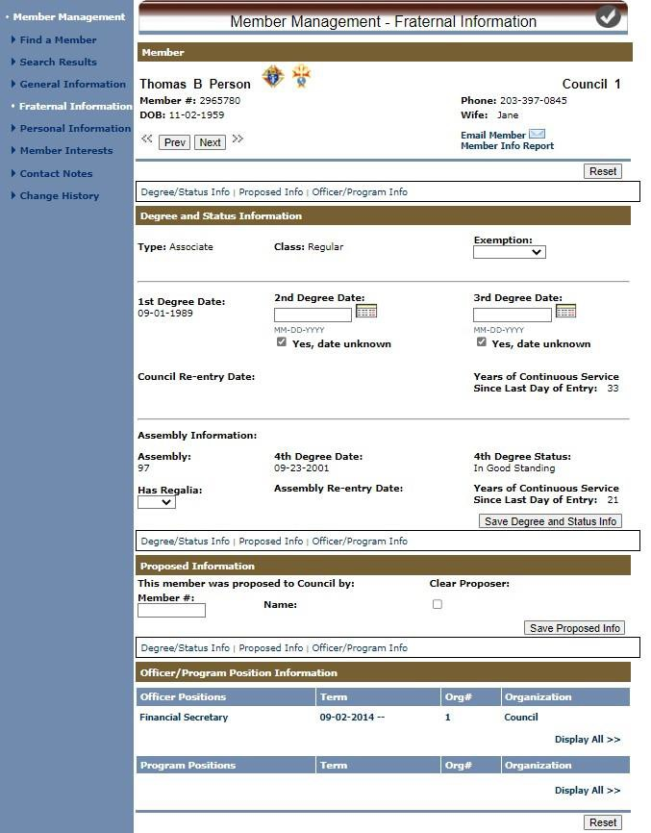
MM – Fraternal Information

Slide 36
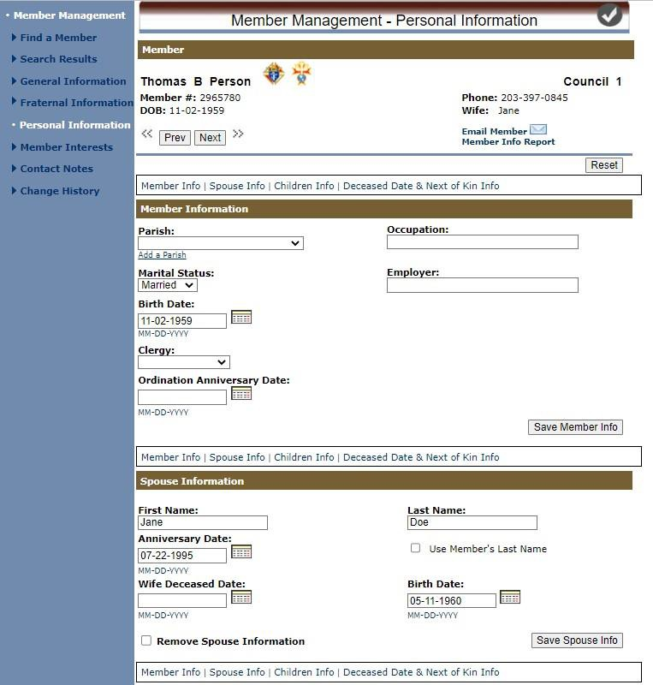
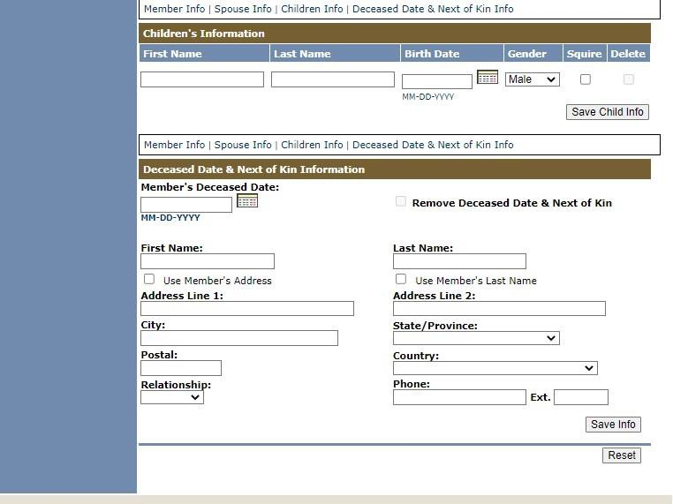
MM – Personal Information

Slide 37
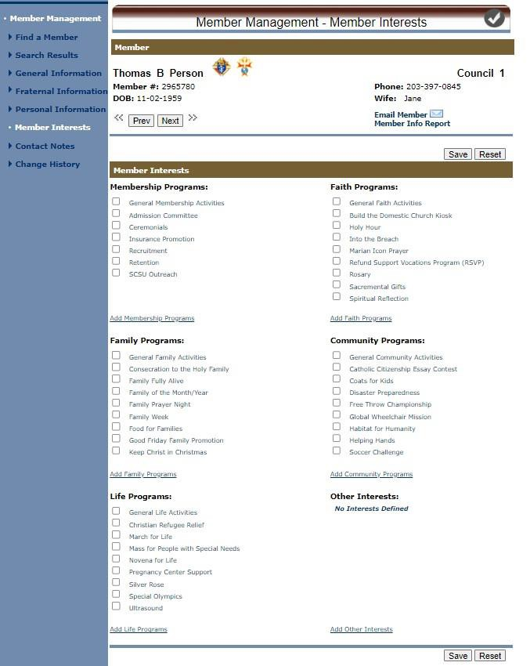
MM – Member Interest Information
You can enter the members
interests
This is like the Member Interest Survey or 1842
NOTE – each area allows you to add additional items of interest
Save when completed

Slide 38
Member Management –
Council Administration

Slide 39
Council admin
Click “Council Administration

Slide 40
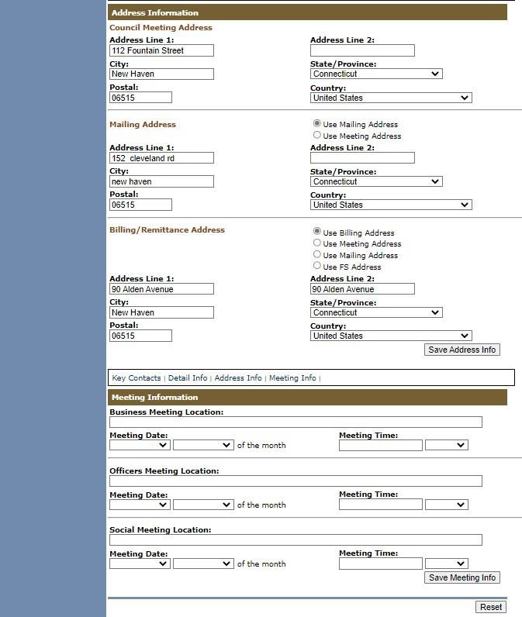
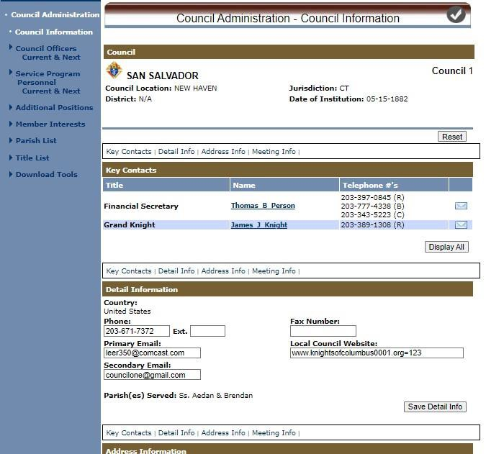
AS YOU SCROLL DOWN
Council Administration
– Council Information

Slide 41
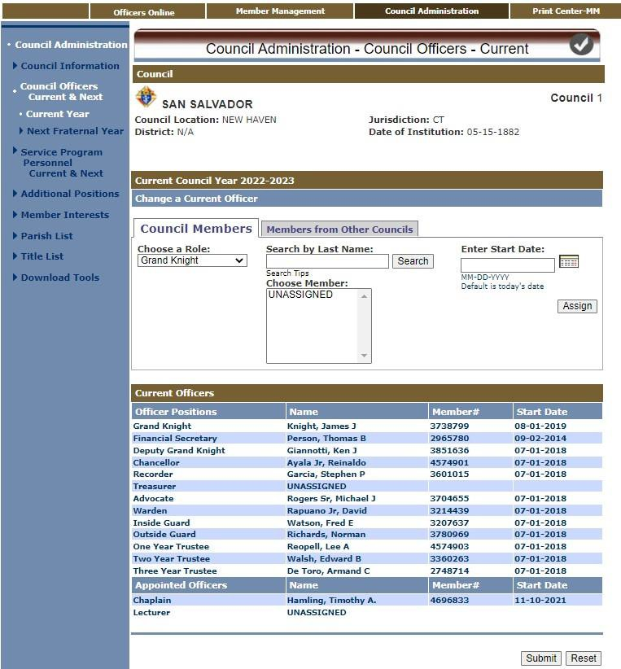
Council Administration
– Current Officers
Shows Current Officers
Select an Officer of choice
Search by last name
Choose member from list
Click “Assign” to add as of today
Click on “Submit” to update
Supreme records
Records purged June 30, 11:59PM

Slide 42
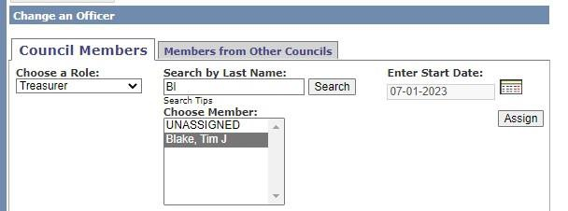
Council Administration
Select “Treasurer” Role
Search by a few letters
“Select” highlighted name
Click “Assign” to update Officer for Council and Supreme as of July 1st

Slide 43
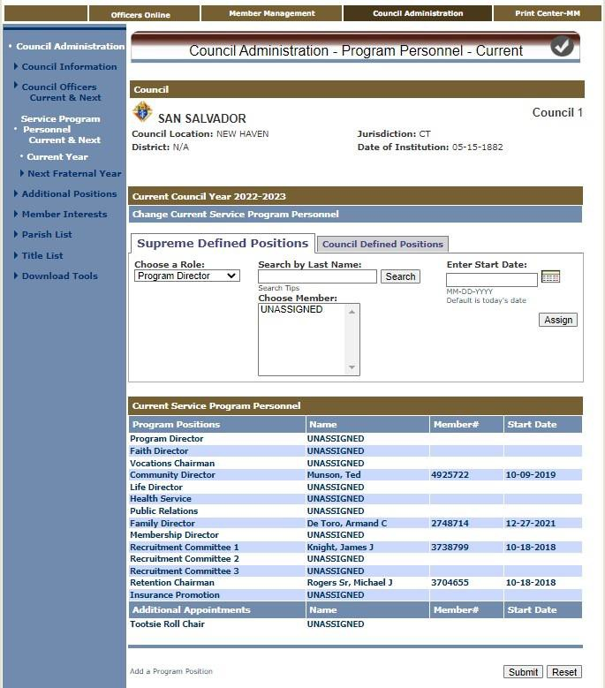
Council Administration
– Current Prog. Person.
Shows Current Program &
Service Personnel
Select a Role of choice
Search by last name
Choose member from list
Click “Assign” to add as of today’s
date
Click on “Submit” to update Supreme records

Slide 44
Council Administration - Updates
Enter Officer & Director updates into Officers or Directors Chosen whenever there is
a change
Do the same following annual Officer elections and GK Director appointments for the next fraternal year
“Copy Current Year” speeds up the process when many are returning
Also, change the new elected or appointed – Then “Submit” the changes to Supreme
When submitted in Member Management, do NOT send paper copies as well
Don’t forget to send report copies from the Print Center to State & District Deputy

Slide 45
Print Center - Member Management

Slide 46
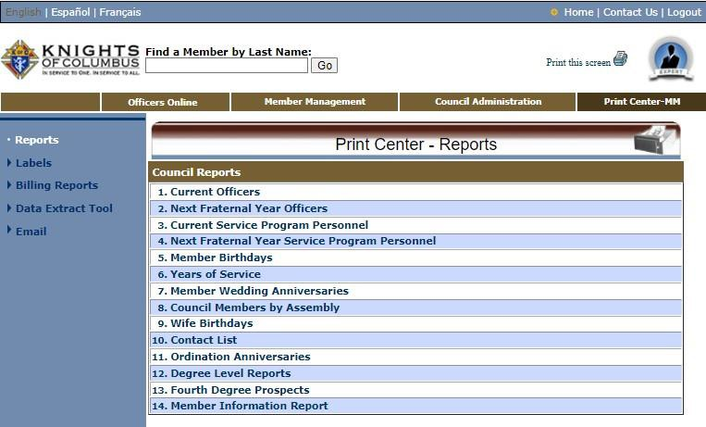
Member Management: Print Center - Reports

Slide 47
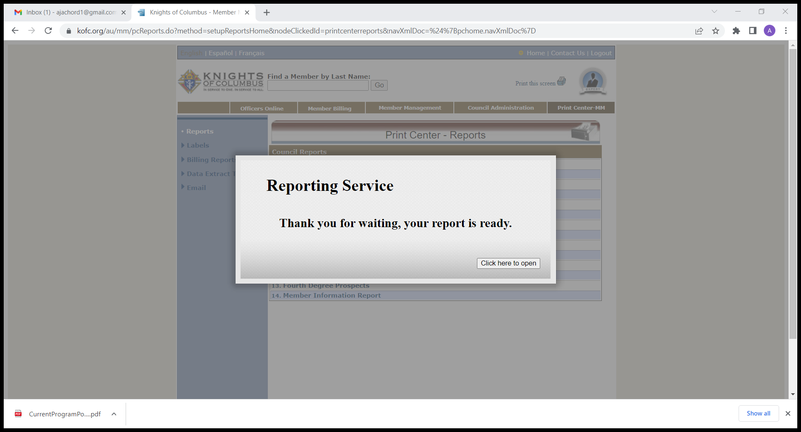
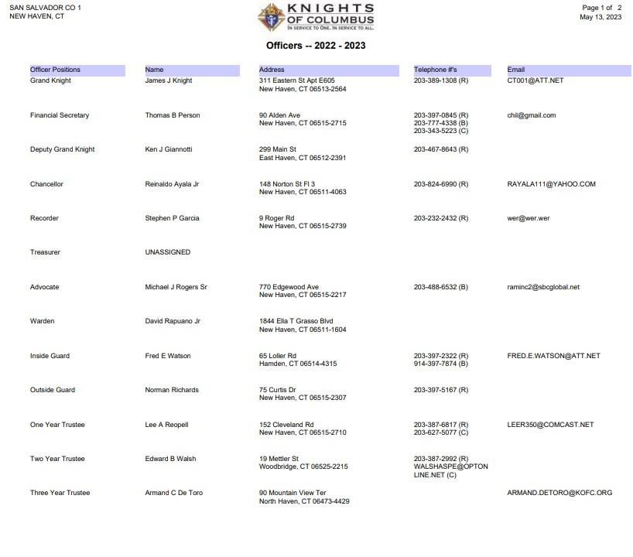
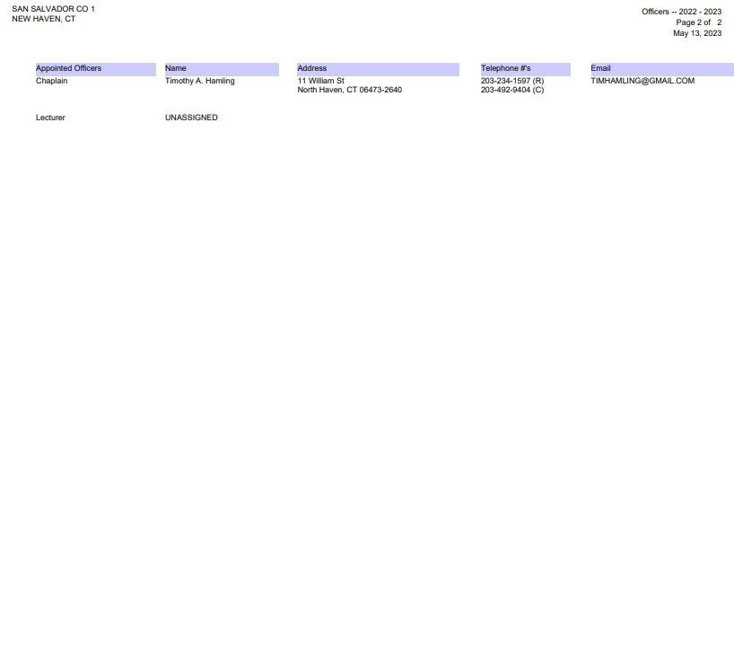
MM Report Examples – 1. Current Officers Chosen

Slide 48
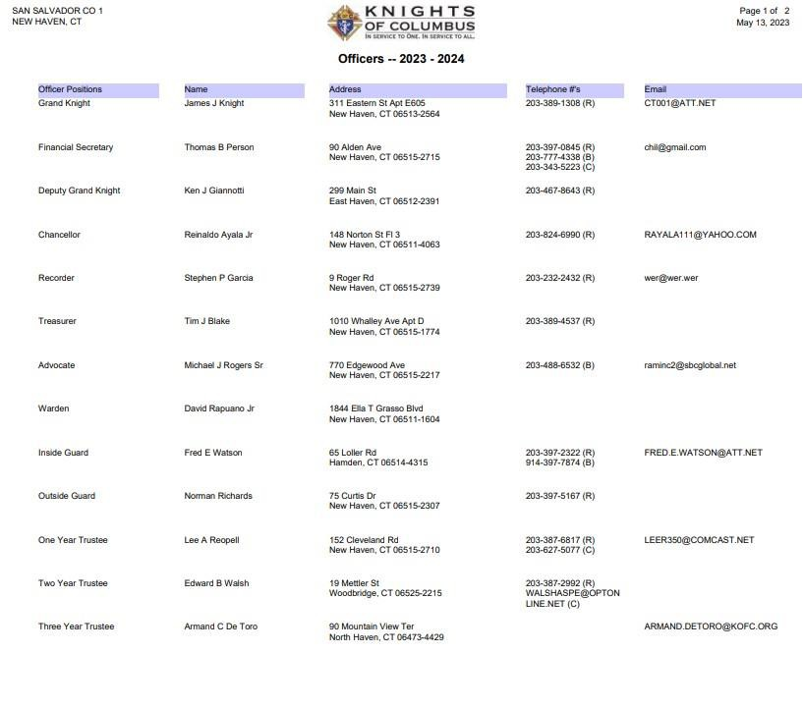
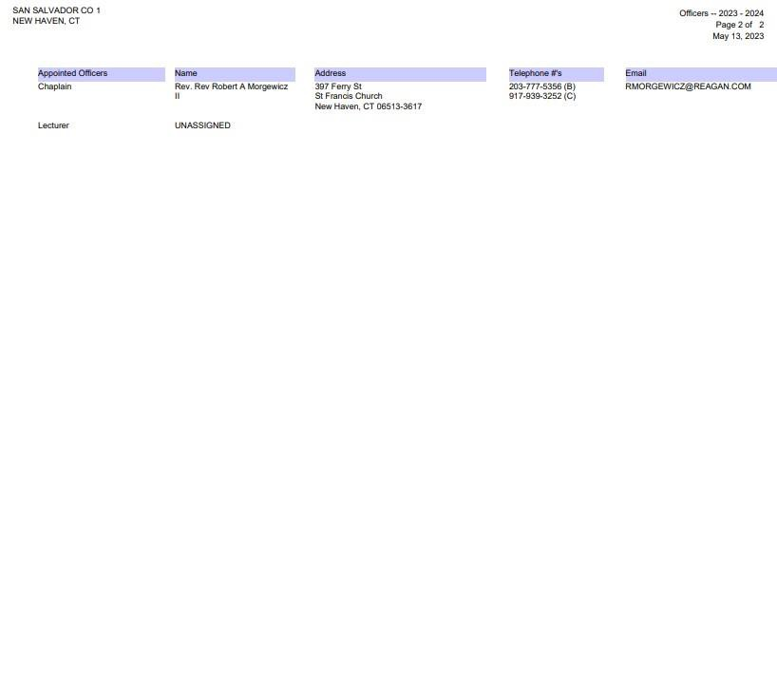
MM Report Examples – 2. Next Year’s Officers Chosen
**Note** - Treasurer role added

Slide 49
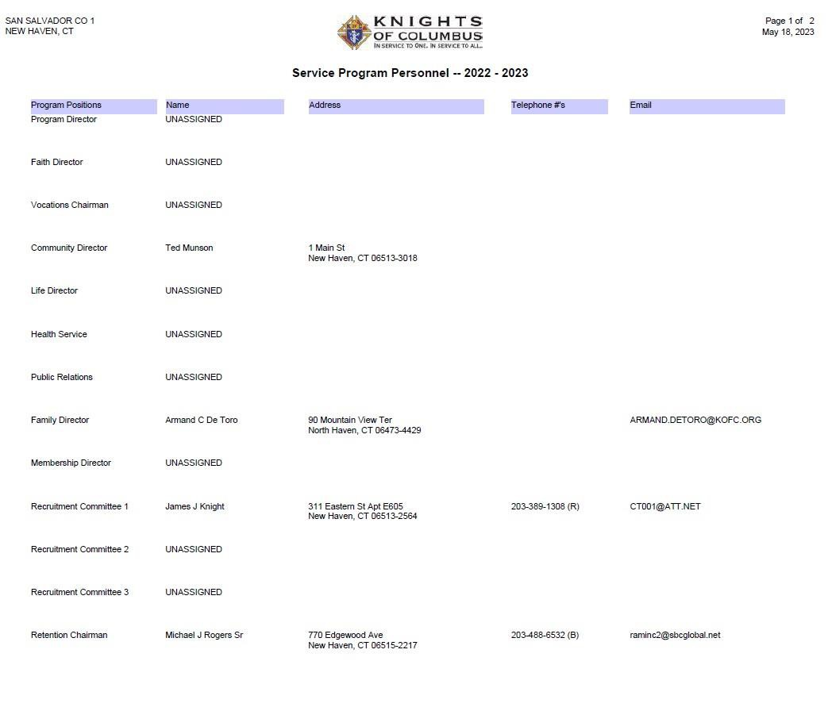
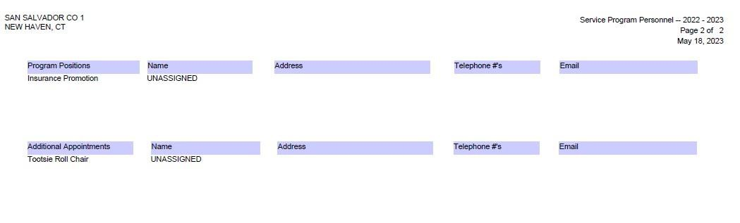
MM Report Examples – 3. Current Program Personnel Chosen

Slide 50
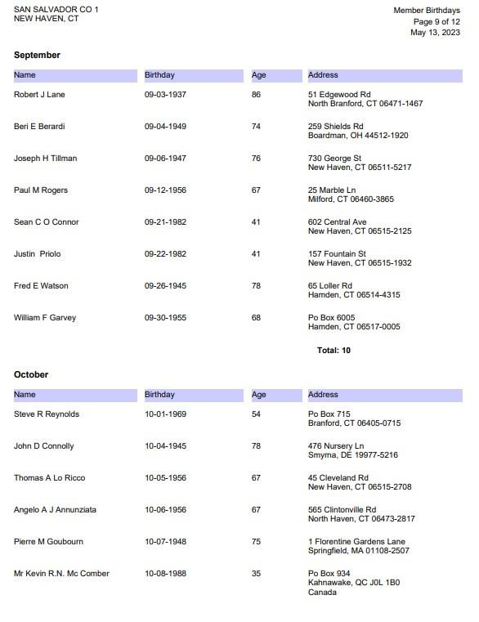
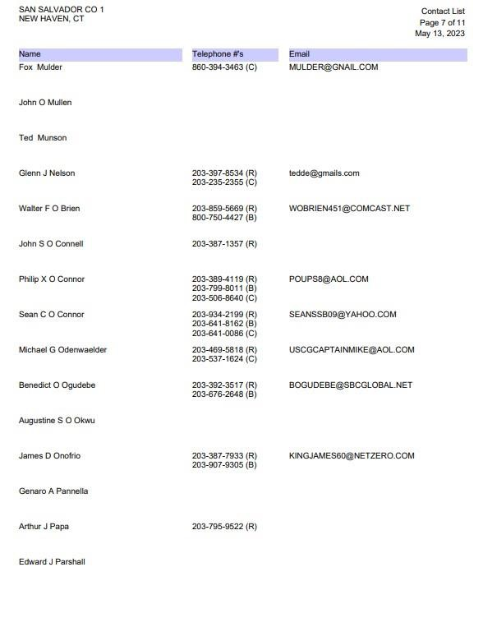
MM Report Examples – 5. & 10. Birthdays & Contact List
Birthdays by Month
Contacts by name, phone & email

Slide 51
Print Center - Member Management Reports
Ordination Date – used for recognizing our clergy
Deceased Level Report – for displaying our deceased members
Fourth Degree Prospect Report – shows 3rd Degree members eligible
Member Information Report – outputs all 4 pages of information for members

Slide 52
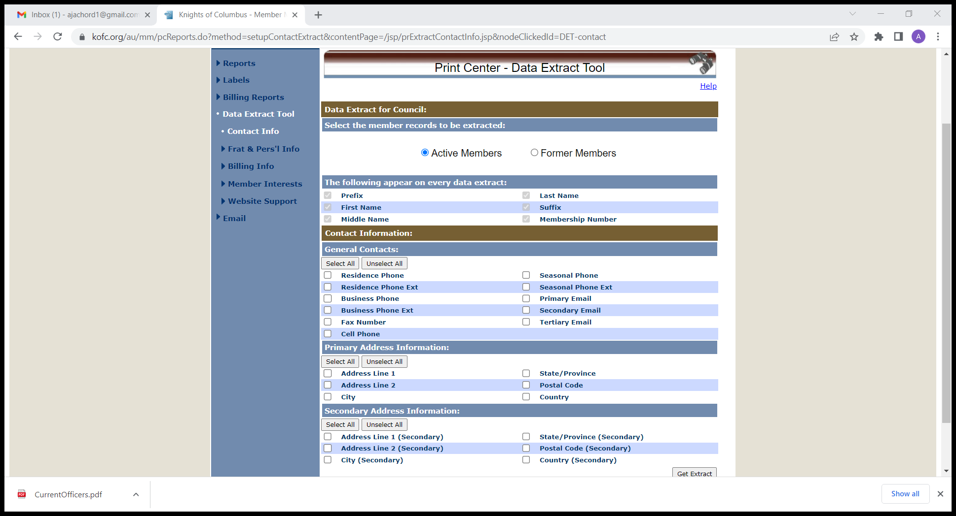
Email Tool

Slide 53
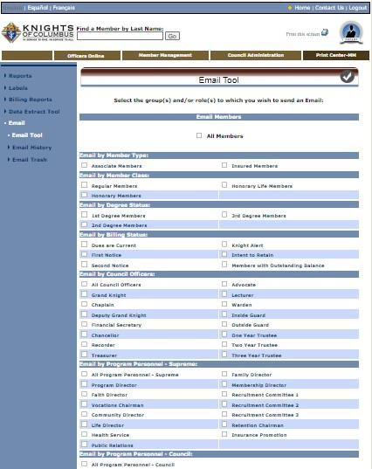
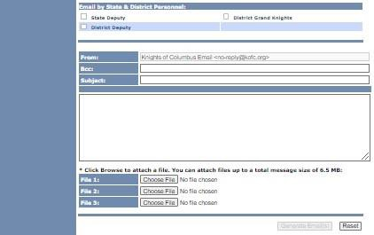
Print Center – Email Tool
Billing statements can’t be sent by groups

Slide 54
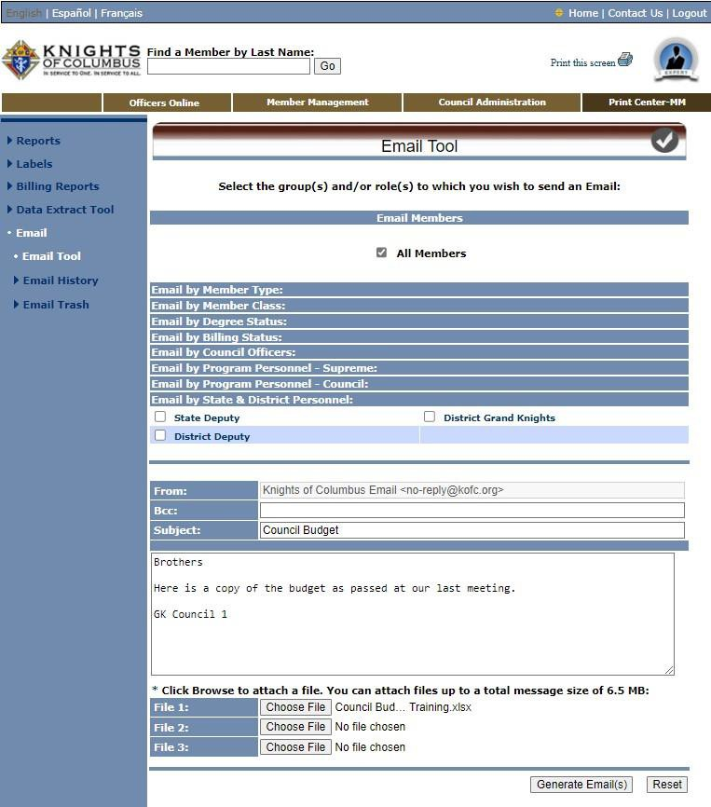
Print Center – Email Example
Select “ALL Members” & the other fields collapse
Enter subject, email text & if needed, attachments
When complete, CLICK “Generate Email(s)”

Slide 55


Print Center – Email Example
When your email is processed you get a “Email Process Complete” message
A record of the message is saved
You can view it in Email History

Slide 56
Email Tool - Summary
Messages can be sent securely to members by type, class & billing status as well as officers, directors, chairmen, the State Deputy, District Deputy and District Grand Knights
The emails are sent though the Supreme server using the noreply@kofc.org domain as blind copies, so no one’s information is visible or shared
Attachments can also be added
All emails are saved and are searchable

Slide 57
Summary
The modules of Member Management & Billing are a secure, self-contained system to work with Council membership and managing financial transactions
Access is gained by Secure log-in to Officer Online, based on the Officer’s role
Entries in both MM & MB are in real time and the data is stored instantaneously – there is no need to follow up with paper copies to Supreme
The system allows for both “Live” & “Training” sessions, enabling you to “practice” without any effect on you Council’s “Live” data
erPoint template

Slide 58
Questions?

